Slide 1

Airline Ticket Booking System
Presented by:
Momina Amjad - 147
&
Aroona Noor - 027

Slide 2
Introduction
Objectives and Key features:
To develop a program enabling users to book airline tickets.
- Domestic and international flight options.
- Region-based fares and seat types (economy, business, first class).
- Meal preferences and discounts.
- Automated fare calculations with tax and seat selection.

Slide 3
Project Overview
Core Components:
Variables & Constants for base fares, discounts, and taxes.
User Inputs for flight details, seat types, and email.
Outputs: Booking summary and fare details.
Workflow:
User selects flight type (one-way/return).
Chooses domestic/international and enters cities.
Provides travel dates, number of seats, and meal preference.
System calculates total fare and books seats.

Slide 4
Design and Implementation
Programming Language: C++
Key Functions:
Base fare adjustments based on region and seat type.
Input validation for seat type, flight type, and meal preferences.
File handling to save booking details.

Slide 5
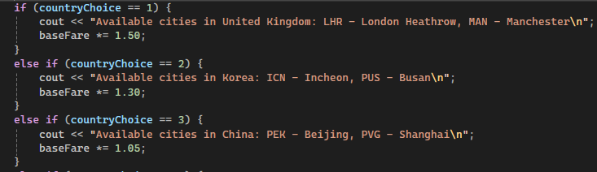
Basefare Adjustment
According to the location and distance

Slide 6
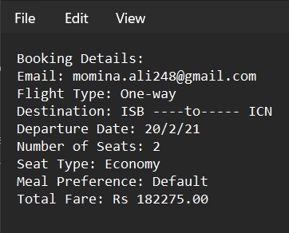
Functionality Demonstration
Booking Example from Text File:

Slide 7
Challenges and Lessons Learned
Challenges:
Ensuring input validation for multiple user choices.
Fare calculation with varying conditions.
Handling multiple seat bookings and meal preferences.
Lessons Learned:
Importance of modular design for readability and maintenance.
Understanding multiple scenarios

Slide 8
Conclusion
Summary:
The project demonstrates an understanding of C++ programming concepts, including file handling, loops, conditionals, fuctions, user input/output as well as 2D arrays.
Future Improvements:
Adding real-time booking verification.
Integrating an online payment system.

